Slide 1
RNN Structures
Present by DW Kim

Slide 2
Contents
1
Seq2seq Model
2
1D-CNN
3
Bi-LSTM

Slide 3
Part One
Seq2seq

Slide 4
RNN: Recap
_______ 데이터를 처리하기에 좋은 뉴럴 네트워크 구조
예시들
음성인식 (speech recognition)
음악 생성기 (music generation)
DNA 염기서열 분석
번역기 (machine translation)
감정 분석 (sentiment classification)

Slide 5
RNN: State-Space Model

Slide 6
RNN: Problem Solving

Slide 7
Machine Translation
je suis un étudiant diplômé
????
I am a graduate student

Slide 8
Recap: N-gram Language Model
I am a graduate student

Slide 9
Seq2seq Model: Structure
je suis un étudiant diplômé
Encoder
Decoder
Context
Vector
I am a graduate student

Slide 10
Seq2seq Model: Structure
je suis un étudiant diplômé
Context
Vector
I am a graduate student
je suis un étudiant diplômé

Slide 11
Seq2seq Model: Teacher-Force Training
je suis un étudiant diplômé
Context
Vector
I am a graduate student
je suis un étudiant diplômé

Slide 12
Seq2seq Model: Full Process
(1) Word Tokenization & Encoding
(2) Training
(3) Validation & Testing

Slide 13

Interim Summary

Slide 14
Part Two
1D-CNN

Slide 15
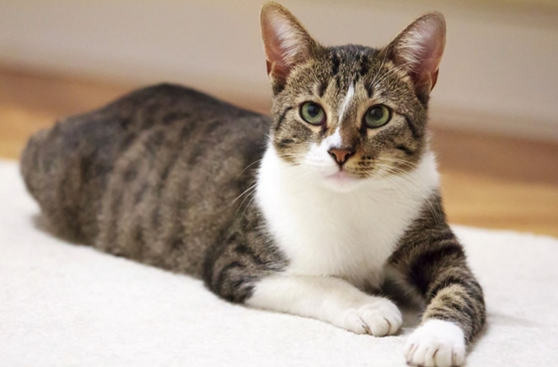
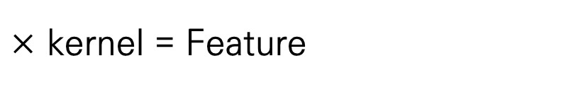
CNN Model
$×$ kernel = Feature

Slide 16
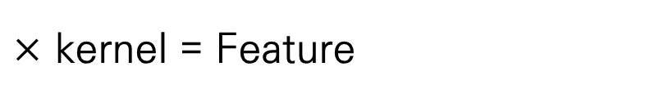
Recap: Word2Vec
I
am
a
graduate
student
$×$ kernel = Feature

Slide 17


1D-CNN Model
I
am
a
graduate
student
$$×$$
$$=$$

Slide 18



Max Pooling
I
am
a
graduate
student
$$×$$
$$=$$
$$→$$

Slide 19
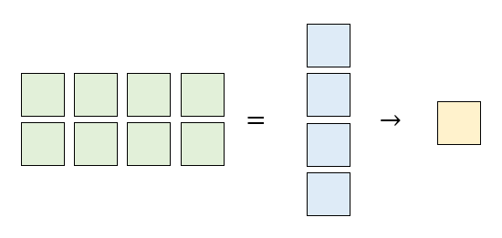

1D-CNN Network Structure
I
am
a
graduate
student
$$×$$
$$→$$

Slide 20
Interim Summary

Slide 21
Part Three
Bi-LSTM

Slide 22
Recap RNN Again

Slide 23
Inference
I love ____ for always

Slide 24
LSTM vs Bi-LSTM
Out
Out
In
In

Slide 25
Interim Summary

